Slide 1

Vasireddy Venkatadri Institute of Technology
Mini Project – Batch 2
Project Guide:
Dr. Sk. Khaja Mohiddin
Team Members:
Susan Peteti – 19BQ1A05M1
Harshit – 19BQ1A05M5
Tummala Swathi – 19BQ1A05N2
K. Vamsi – 19BQ1A05N7
V. Hanusha - 20BQ5A0524

Slide 2
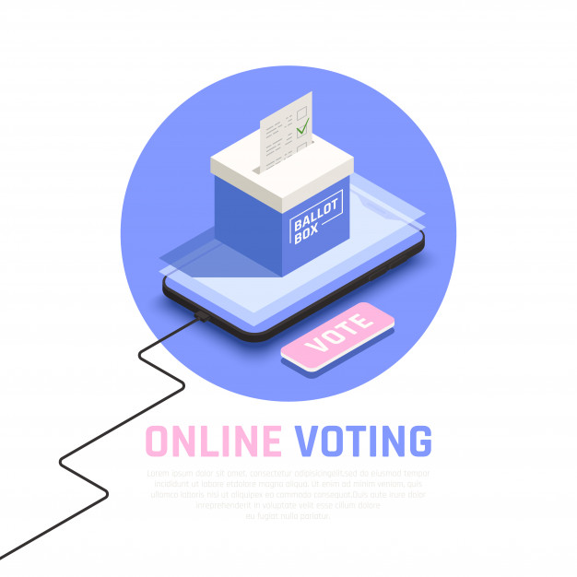
Online Voting System

Slide 3
Contents
Problem statement
Proposed solution
Security issues
Modules
Screenshots
Conclusion

Slide 4
Problem Statement
Voting is important to make a collective decision or express an opinion. Online voting system allows a voter to easily caste a vote from any location; accurate counting of votes and easy monitoring.
Voting is usually held using ballot system or using EVMs. These systems have their drawbacks.
Online voting system is introduced to overcome them.

Slide 5
Proposed Solution
The proposed solution is to implement a system where an election can be held online and an approved voter can see his/her ballot and vote.
The proposed solution enhances the security of the system to some extent.

Slide 6
The system has two types of users, Admin and user/voter.
The admin has access to creating elections, viewing results and approve voters.
The users have access to vote and to see results.
The voters cannot cast vote twice unless the election is held again under certain circumstances.

Slide 7
Security issues
In the existing system, anyone who register is eligible to vote.
In the existing system, anyone who knows a voter’s login credentials can vote.

Slide 8
System Requirements
Operating Environment
Django
Python Language
HTML5, CSS, javascript
Windows 11

Slide 9
Modules
virtualenv
django
django-widget-tweeks
Django-renderpdf

Slide 10
virtualenv:
The virtualenv module is a tool to create isolated Python environments. This module is often used to create Django projects.
django:
Django is a back-end server side web-framework. Django is free, open source and written in Python. Django makes it easier to build web pages using Python.
django-widget-tweeks:
Tweak the form field rendering in templates, not in python-level form definitions. Altering CSS classes and HTML attributes is supported.

Slide 11
Django-renderpdf:
This model is used to convert html pages to pdfs. This module is mainly used in downloading results.

Slide 12
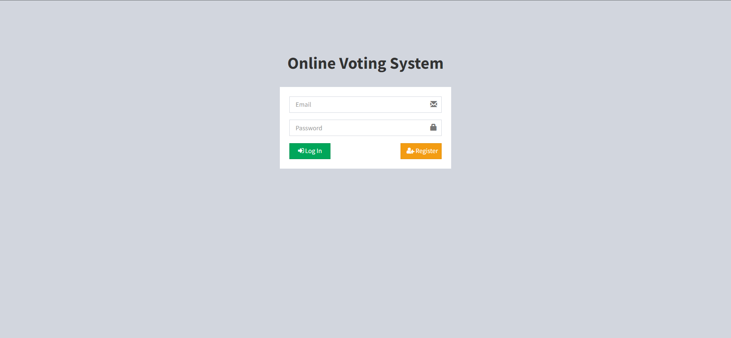

Slide 13
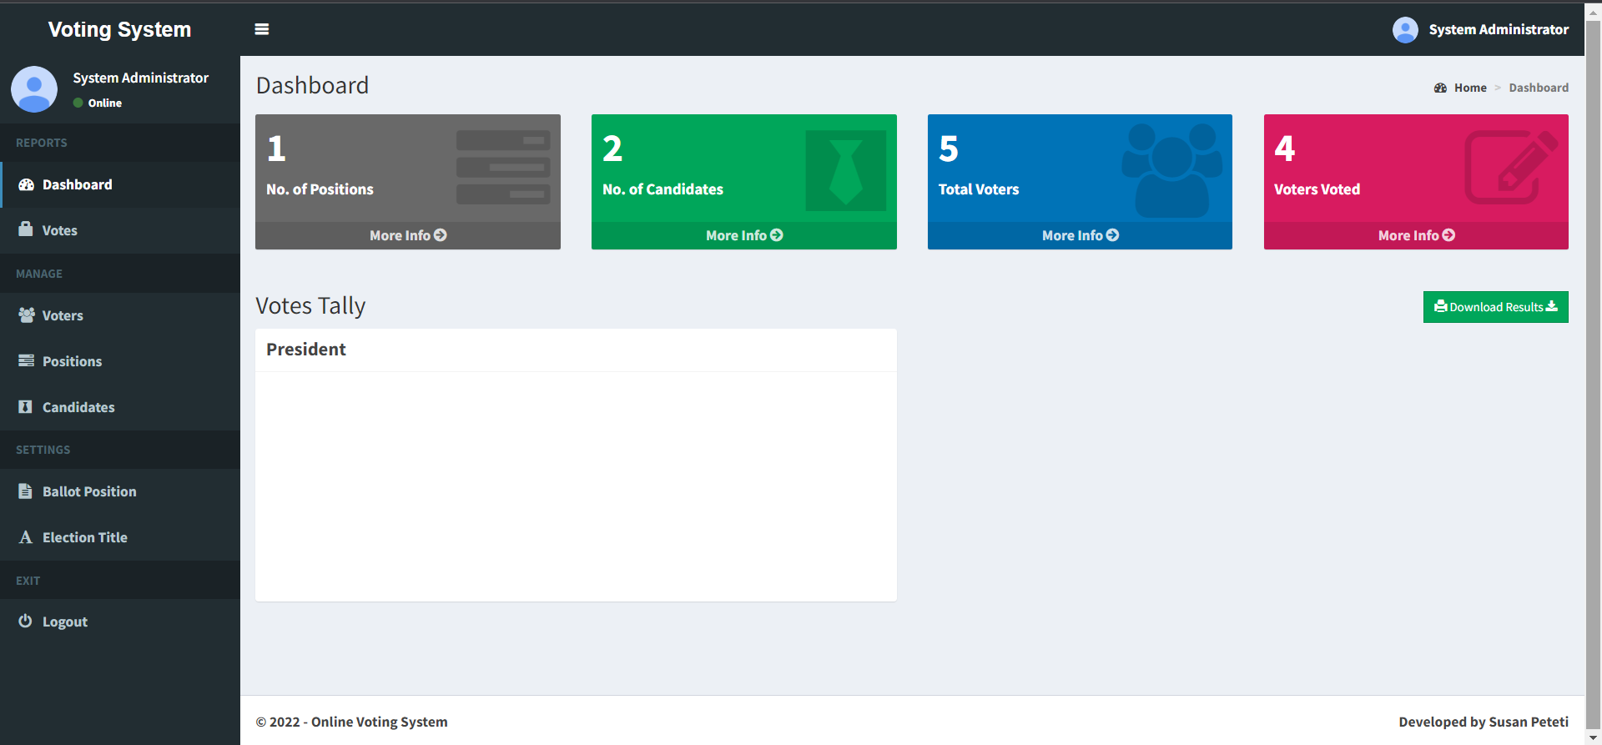

Slide 14
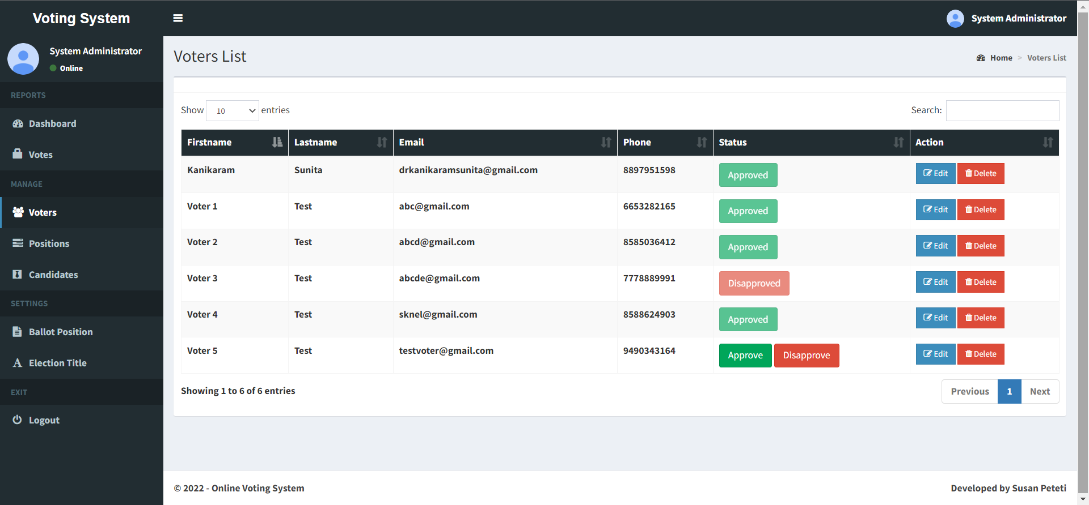

Slide 15
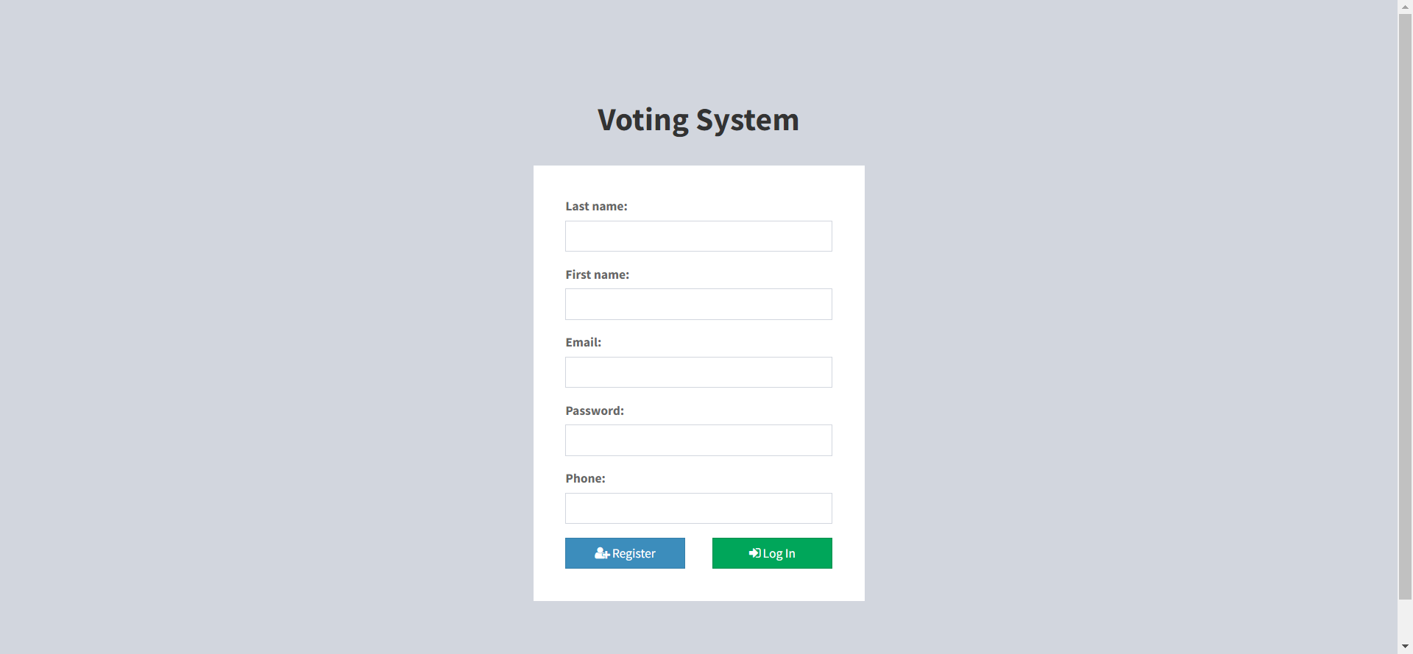

Slide 16
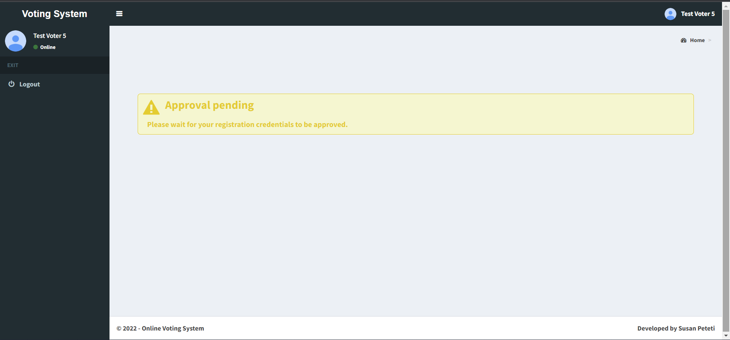

Slide 17
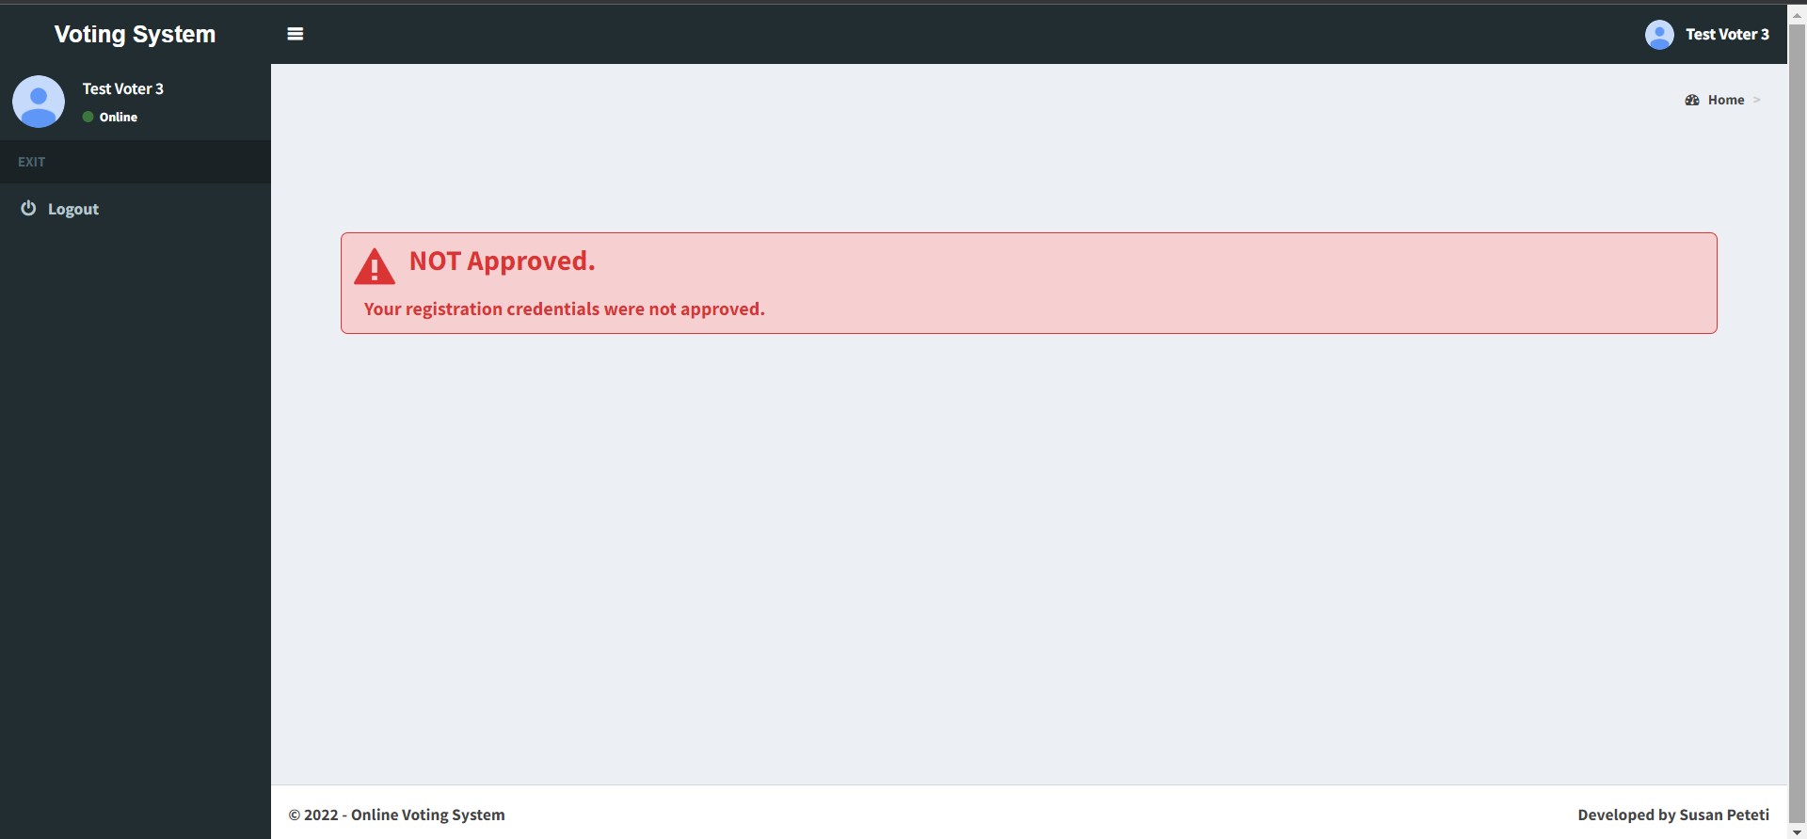

Slide 18
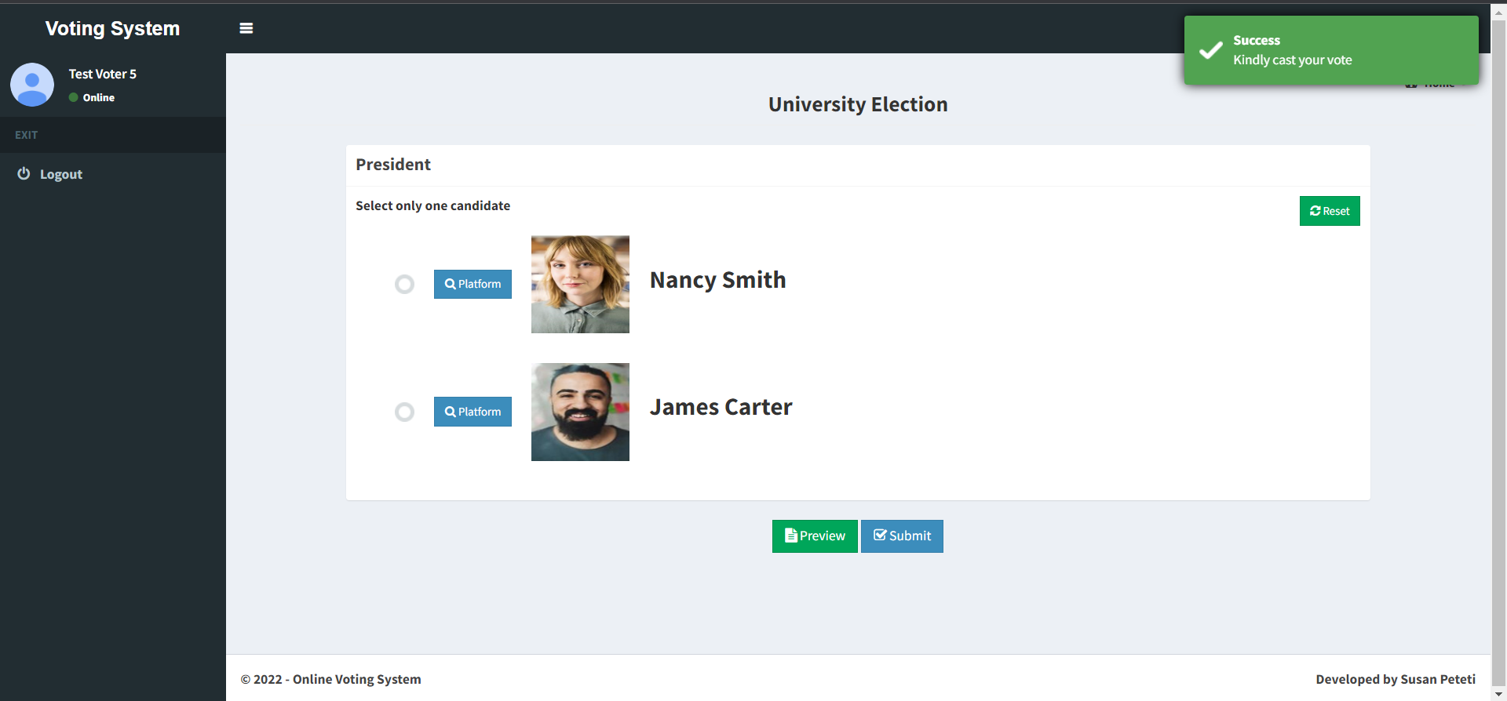

Slide 19
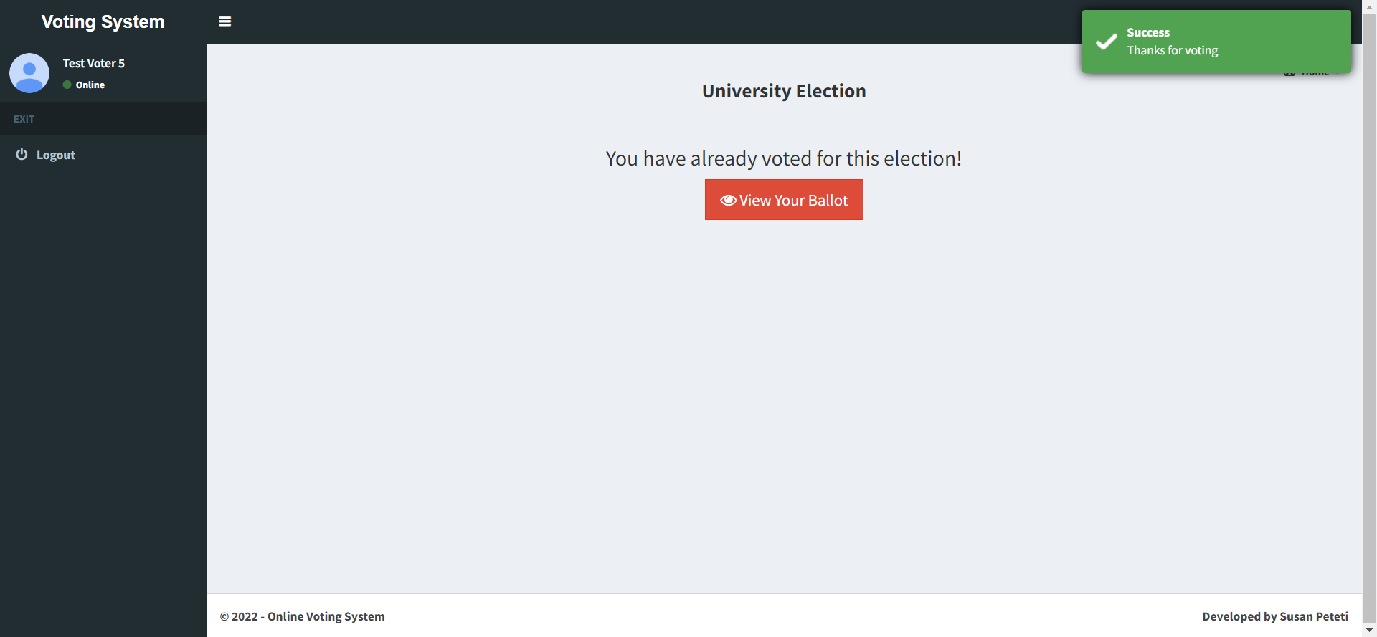

Slide 20
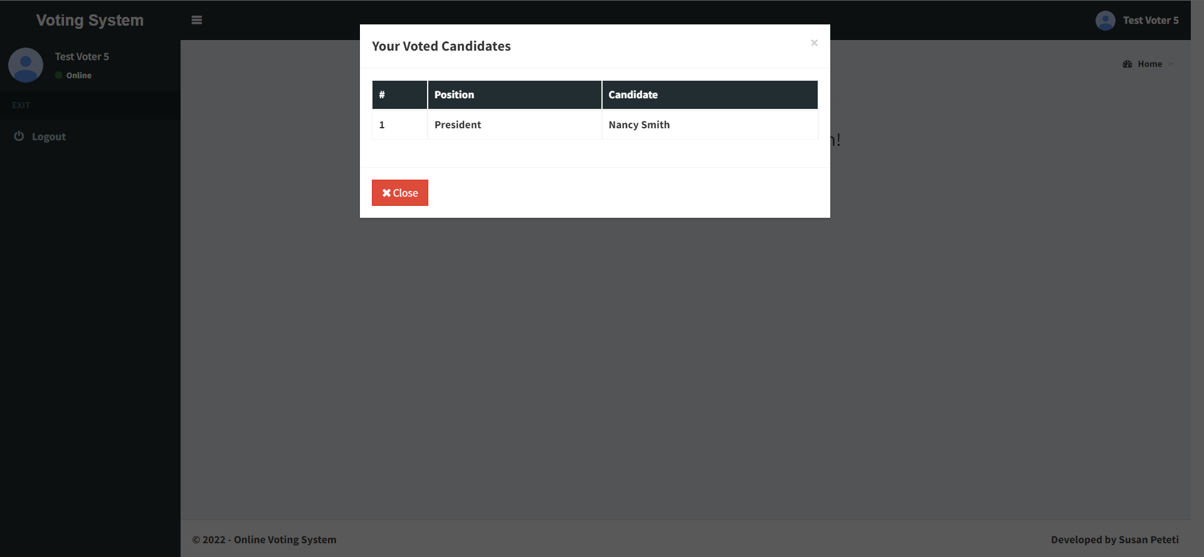

Slide 21
Conclusion
The system provides a secure platform for voting.
The voter cannot voter or view the elections unless he/she is approved by the admin.
The admin has permissions to see the voter, approve voters and generate results.
The future scope: Voter authentication can be done using and OTP before starting the election process.

Slide 22
Thank You

